Slide 1
Academic Advising 101
General Advising Website:
advising.ecu.edu
General Advising Email:
advising@ecu.edu
Notes:
Welcome participants
Introduce yourself and your role
Invite participants to take pictures or screenshots of the presentation for later reference if helpful
Provide instructions to enter questions about topics being covered in the chat – we will answer as many as possible at the end of the presentation

Slide 2
Majors by College
COLLEGE | MAJORS
Allied Health Sciences | Clinical Lab Science, Health Services Management, Health Information Management, Nutrition, Rehabilitation Services
Arts & Sciences | Anthropology, Biology, Chemistry, Criminal Justice, Economics, English, Foreign Languages & Literatures, Geography, Planning and Environment, Geology, History, Math, Neuroscience, Philosophy & Religious Studies, Physics, Political Science, Psychology, and Sociology
Business | Accounting, Finance, Management, Management Information Systems, Marketing, Supply Chain Management, Entrepreneurship, and Hospitality Management
Education | Elementary Education, Middle Grades Education, English Education, History Education, Math Education, Science Education, and Special Education
Engineering & Technology | Computer Science, Construction Management, Engineering, Technology Systems
Fine Arts & Communication | Art & Design, Communication, Music, Theatre, and Dance
Health & Human Performance | Public Health Studies, Human Development & Family Science, Interior Design & Merchandising, Kinesiology, Recreation Sciences, Social Work, Child Life, and Exercise Physiology
Nursing | Nursing
Major Advising Program* | Deciding Students
Honors College* | Includes students from across colleges
01
*Not a specific college
Notes:
Explain structure of majors and advising at ECU

Slide 3
ADVISING CENTER EMAIL ADDRESSES
Allied Health Sciences
& Pre-Professional Advising PPAC@ecu.edu
Arts & Sciences:
THCASadvising@ecu.edu
Business:
COBadvising@ecu.edu
Communication:
COMMadvising@ecu.edu
Education:
COEadvising@ecu.edu
Engineering & Technology:
CETadvising@ecu.edu
Fine Arts (Theater & Dance):
SOTDadvising@ecu.edu
Fine Arts (Art):
ARTadvising@ecu.edu
Fine Arts (Music):
SOMadvising@ecu.edu
Health & Human Performance:
HHPadvising@ecu.edu
Nursing:
CONadvising@ecu.edu
Major Advisement Program (Undecided):
MAPadvising@ecu.edu
Notes:
Explain communication methods for advising – email is typically best, especially during the summer
Until you have an assigned academic advisor, please send questions to the appropriate advising center’s team email address

Slide 4
1
Prepare for Registration
Review PIER website (pier.ecu.edu)
Monitor ECU email account for additional information from the college of your major
2
Register for Fall Classes
Contact your advising center via email to confirm major & receive unique PIN​
Use the course guide for your major from step 2 on PIER to select initial classes​
If you need assistance, please reach out to your advising center
Registration &
Advisor Assignment
3
Check your ECU Email
Advising centers are assigning advisors to students who are registered
Monitor your ECU email for an introduction from your assigned advisor
Notes:
Review steps listed on slide
Encourage students to register ASAP so they can be assigned an advisor.
Initial fall schedules do not have to be perfect or complete.

Slide 5
GENERAL ADVISING WEBSITE
advising.ecu.edu
Advisor Center Contact Information:
Links to center websites
Contact list by major (alphabetical)
Major Information:
How to choose a major
Major descriptions & curriculum plans
Major requirements (link to undergrad catalog)
Class Registration:
General education requirements
Understanding registration holds
Registration tutorials
Common registration errors & how to solve them
Registration tips (math placement, foreign language placement, searching for courses, etc.)

Slide 6
STUDENT & ADVISOR RELATIONSHIP
Expectations
ADVISORS:
STUDENTS:
Discuss major requirements
Assist you in selecting courses
Help you stay on track
Provide accurate and timely information
Be knowledgeable of campus policies and procedures; make referrals
Serve as a guide in decision making
Respect advisees as individuals
Check ECU email daily
Communicate concerns ASAP
Be familiar with major requirements
Make your own decisions and set your own goals (with our guidance)
Follow through on recommendations and strategies discussed
Prepare for advising appts each semester

Slide 7
FERPA
Family Educational Rights & Privacy Act
Gives students the right to review, seek changes, and limit the sharing of their educational records
Prohibits ECU staff and faculty from sharing your academic information with ANYONE
FERPA/Buckley form available in Pirate Port – allows you to grant permission

Slide 8
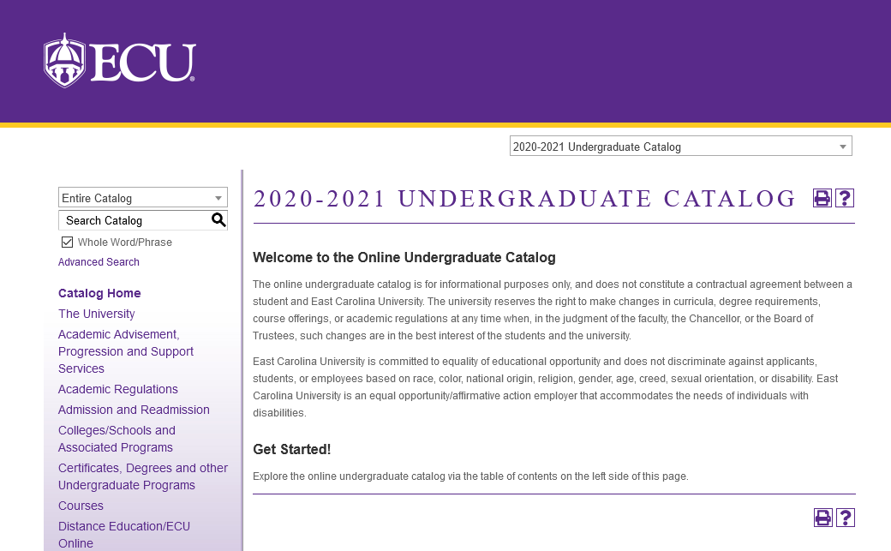
Describes academic program requirements, student services, academic regulations, course descriptions, etc.
The university expects that students will be familiar with the content of the catalog.
Part of your academic advisor’s role is to also be familiar with the catalog in order to provide guidance and recommendations.
Catalog is valid 5 years
Undergraduate
Catalog
catalog.ecu.edu

Slide 9
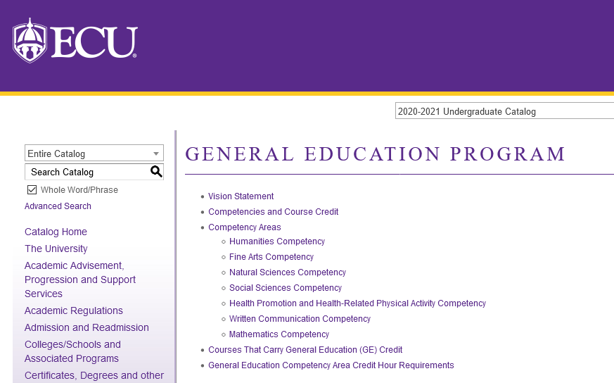
The goal is for students to develop an understanding of aspects of the human condition that are not the primary focus of their major field of study. General education requirements will vary major to major.
Gen Ed Competency Area | Hrs
English Composition | 6
Natural Sciences (at least 1 lab) | 7
Mathematics | 3
Humanities & Fine Arts (min. 1 from each area) | 9
Social Sciences (from 2 or more disciplines) | 9
Health & Kinesiology | 3
Gen Ed Elective | 3
TOTAL HOURS: | 40
General
Education
Additional requirements within or in addition to the above:
One course must be GLOBAL DIVERSITY (GD)
One course must be DOMESTIC DIVERSITY (DD)
Four courses must be WRITING INTENSIVE (WI)
Notes:
may be a large portion of your fall schedule – often courses that are 1000 and 2000 level

Slide 10
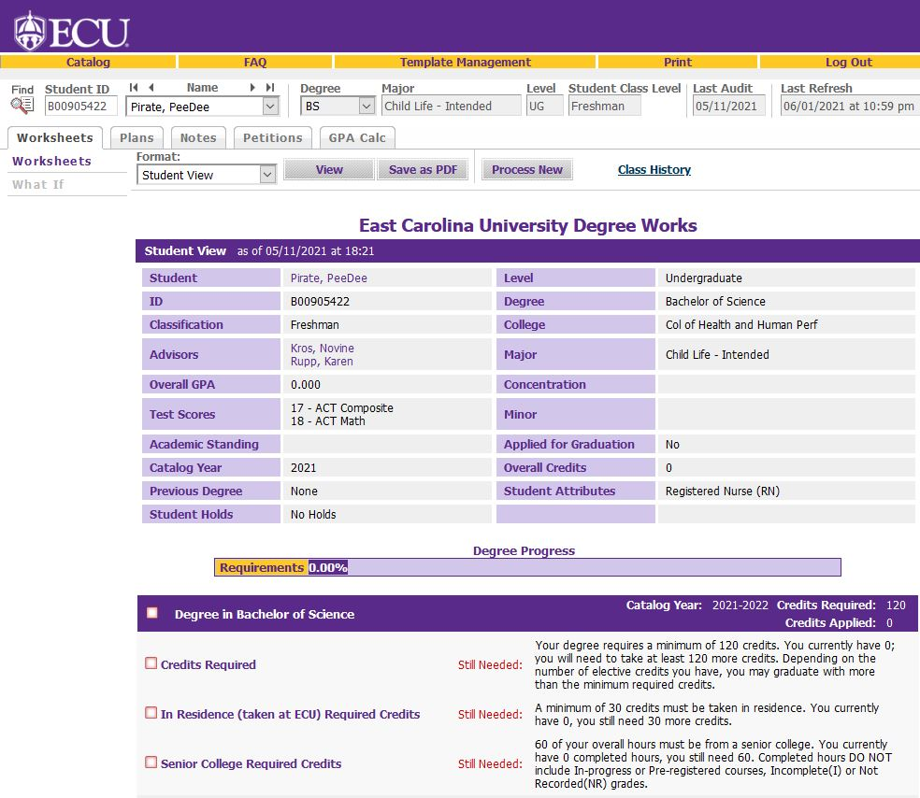
Degree Works
Tracks student degree progression
Use will vary from college to college
Accessible to students in Pirate Port
Must use Internet Explorer or Firefox
Cannot use on mobile devices

Slide 11
SCHEDULE
BASICS
Register for classes ASAP if you have not already done so.
Refer to major course guides under Step 2 of PIER to learn appropriate first semester course options for your major.
Classes are categorized into levels:
1000 level = Freshmen
2000 level = Sophomore
3000 level = Junior
4000 level = Senior
You can take courses above your classification level if you meet other required prerequisites.
All ECU degrees require at least 120 credit hours to graduate.
Freshman = 0-29 credits earned
Sophomore = 30-59 credits earned
Junior = 60-89 credits earned
Senior = 90+ credits earned
Average 14-17 hours/semester to graduate in four years

Slide 12
I’m bringing in credit from high school...
Early College | Dual-Enrollment | AP & IB
Connect with Advising
Send Transcript/Scores
Monitor Banner Transcript
Email your assigned advisor or your advising center for more specific guidance on choosing first semester courses.
Include your Banner ID and send PDF of unofficial college transcript or screenshot of courses & final letter grades.
Electronically (recommended):
admissions@ecu.edu
Postal Mail:
Office of UG Admissions
Mail Stop 517
East Carolina University
Greenville, NC 27858-4353
Monitor your ECU unofficial transcript in Banner Self-Service. Once transcripts and scores are received and processed, transfer and test credit will appear at the top of your transcript.
Contact your advisor with questions

Slide 13
Math Placement math.ecu.edu/placement
ECU Math Courses | SAT Math | ACT Math | ECU Math Dept
MATH 1050, 2228 | No score required | No score required | No score required
MATH 0001, 0045 | 0-560 | 0-22 | 0-16
MATH 1064, 1065, 2127, 2283 | 570 or higher | 23 or higher | 17 or higher (exam 1)
MATH 1083, 2119, 2121 | 600 or higher | 25 or higher | 12 or higher (exam 2)
MATH 2171 | 650 or higher | 28 or higher | 12 or higher (exam 3)
AP Calculus Exams:
Scoring a 3 or higher on the AP Calculus AB or BC exams will earn students college level calculus credit
Students earning this credit through AP should connect with their Academic Advisor to determine how the credit will apply to major math requirements
Important Notes:
Scores simply determine math placement – you do not earn college credit
MATH 1065 registration is restricted through August 2 to math priority majors ONLY
MATH 0001/0045 are remedial courses – they count toward GPA but college credit is not earned and credit hours are NOT included for financial aid purposes

Slide 14
ECU Math Placement Exam in Canvas
canvas.ecu.edu
math.ecu.edu/placement
NOT REQUIRED if you qualify for math placement in your major based on ACT or SAT math score
Accessible any time in your Canvas account
Recommended to complete before Fall starts
Two attempts on the exam if needed
Content review modules provided in Canvas
Notes:
Contact advisor for questions related to math and your major’s requirements
Contact Sandy if you have questions about the Canvas exam specifically

Slide 15
COAD 1000
Recommended Elective
Sample
Course Topics:
COAD 1000 is a 1 credit elective course available to you the first semester you are a student at ECU. It is not required, but we encourage you to consider taking the course fall semester if you can fit it in your schedule.
Study Skills
Time Management
Campus Resources
Student Involvement
Career Exploration
Major specific sections are taught by advisors
Will be in-person, two days a week
*Found under Counselor Education in Banner

Slide 16
Academic Calendar Fall 2021
Date | Event or Deadline
August 23 | Classes Begin
August 27 | Last day to make schedule adjustments by 5:00pm
September 6 | Holiday – No Classes
October 9-12 | Fall Break – No Classes
November 1 | Last day to request a course or term withdrawal without grades by 5:00pm
November 5 | Early Registration for Spring 2022 begins
November 24-28 | Holiday – No Classes
December 6 | Classes End
December 15 | Exams End
Tuition and fee statements post in July
Payment due early August
Monitor Cashier’s Office website: https://financialservices.ecu.edu/cashiers-office/
Notes:
Highlight tuition statement and payment deadline
Highlight window for schedule changes and mention briefly ability to withdrawal after first week if needed through posted deadline

Slide 17
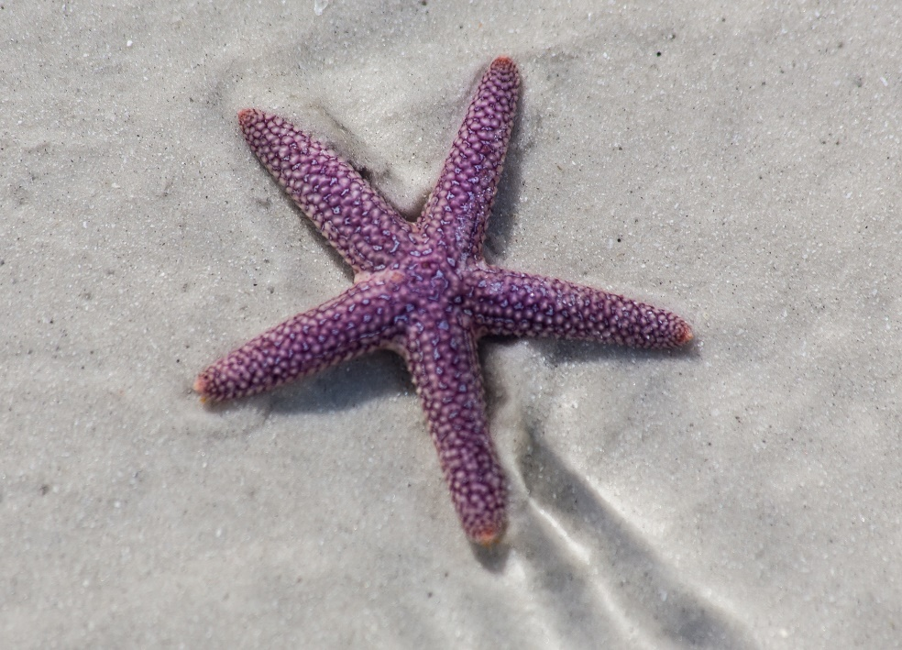
Starfish
Early alert system used by faculty to support your academic success in their course
Professors send students feedback by submitting “kudos” or “raising flags”
Starfish notifications sent to ECU e-mail
Advisors receive a copy of the notifications and will reach out when necessary.

Slide 19
Academic Performance Standards
“Good standing” at ECU:
2.00 ECU cumulative GPA
Many majors will require higher than a 2.00 to declare.
1st Semester under 2.00 = Academic Warning
2nd Semester under 2.00 = Academic Probation
3rd Semester under 2.00 = Academic Suspension
Freshmen who fail all their first semester classes are automatically suspended from the university.

Slide 20
PROFESSIONAL PERFORMANCE STANDARDS
MAKE A GREAT FIRST IMPRESSION:
Attend class regularly and participate
Introduce yourself to faculty the first week
Be on time and prepare (class, appointments, etc.)
Review syllabi and email communication carefully
EMAIL COMMUNICATION:
Check ECU email daily including spam/junk folder
Always use your ECU email to communicate with faculty and staff at the university
Be sure to include your Banner ID
Use clear, concise language and provide details
Use correct greeting (Professor/Dr./Mr./Ms.)

Slide 21
Final Advising Reminders & Tips
Be sure to check your ECU student email DAILY (even on weekends)
Go ahead and memorize your Banner ID and include it in every email (under your name is a great place!)
Send final, official high school AND college transcripts to ECU Admissions as soon as possible (monitor your ECU transcript in Banner for processed credits)
Review the PIER website at pier.ecu.edu, contact your advising center to receive your registration PIN, and register for classes (if you haven’t already – this is what triggers your advisor assignment!)
Complete the math placement exam in Canvas if your SAT and/or ACT math scores are not high enough for placement in your major (or if you did not take the SAT or ACT exams).
Communicate regularly with your advisor if you have any questions or concerns. We are happy to help!

Slide 22
Questions about General Advising?
Specific questions related to your unique major requirements, class schedule, registration issues, etc. should be emailed to your assigned academic advisor. If you do not have an advisor assigned yet, please submit questions to the advising center of your major. Thank you!

